Slide 1
Missing and Filled Capsule Detection
Abdullah Çifci
Batu Berke Mungan
Ege Kuzu

Slide 2
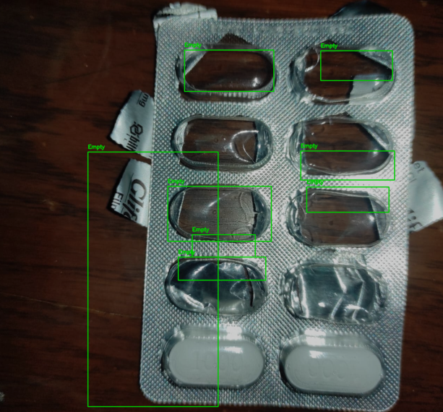
We need to obtain contours and histograms in the medicine box to make comparisons.
Since histogram comparisons are based on contours, it is necessary to adjust the contours according to the photographs.

Slide 3
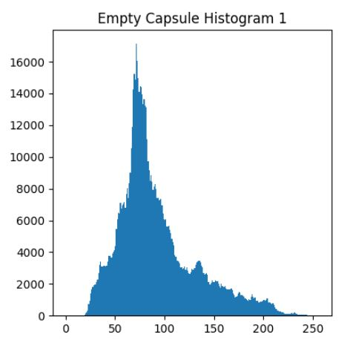
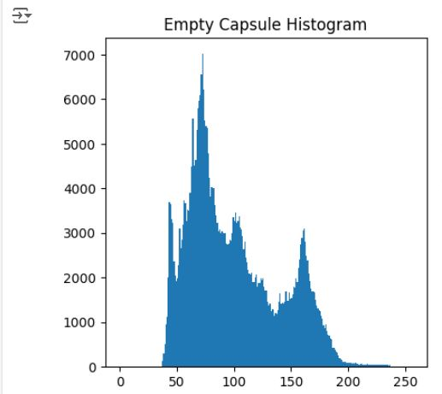

Slide 4
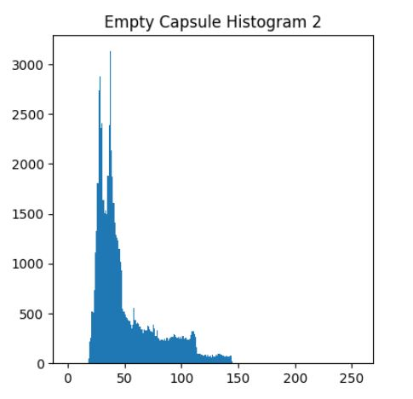
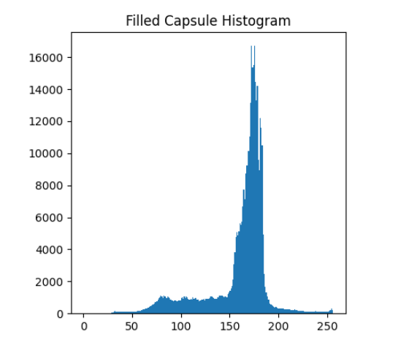

Slide 5
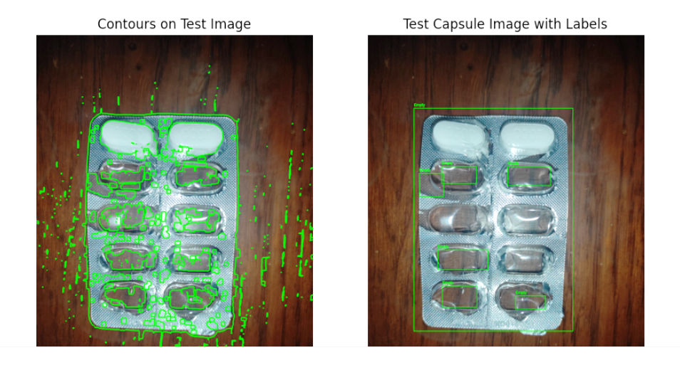
Inability to detect drug capsules prevents histogram comparison, so scanning could not be done in many areas. Also the medicine package we used for test image is quite damaged, it makes detection difficult.)

Slide 6
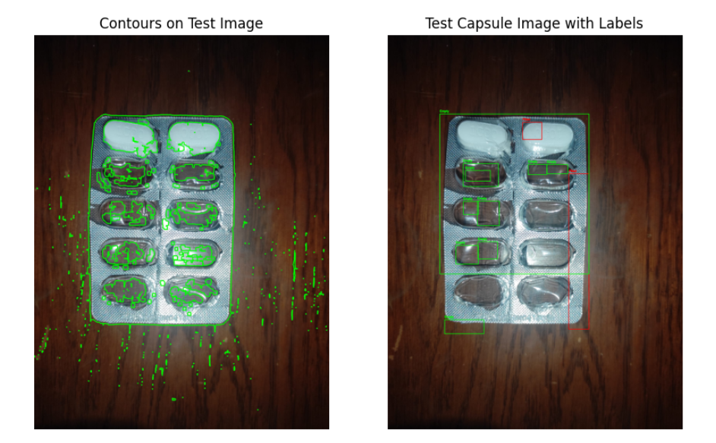
Noise decreased slightly with the filters, but the detection was still not successful due to the drug package being slightly damaged and contours not being fully captured.

Slide 7
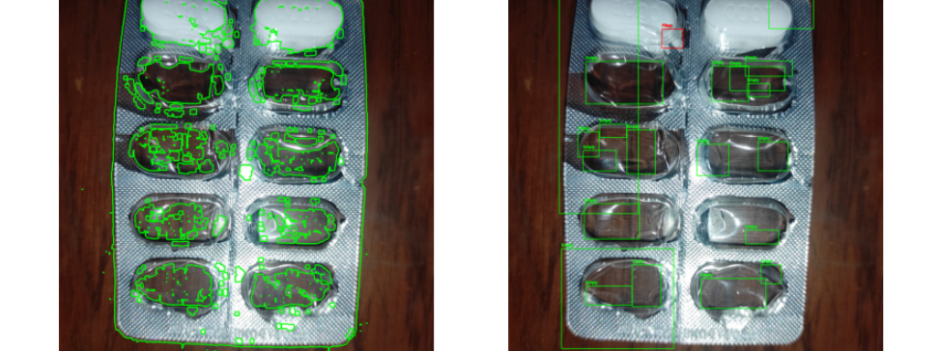
More filter, less noise and still determining conturs are impossible, so need to change conditions.

Slide 8
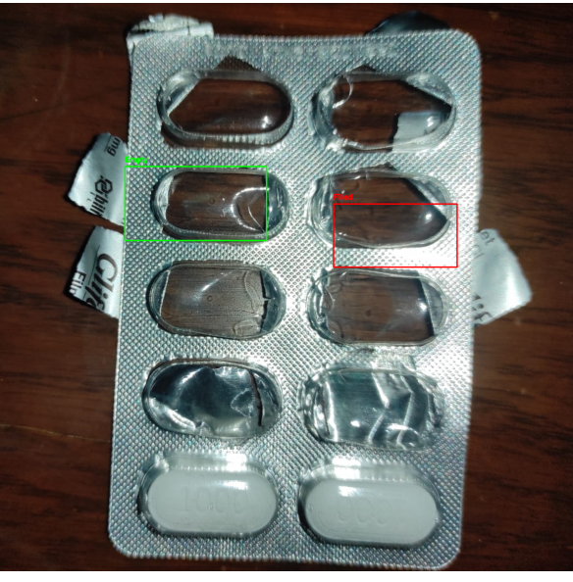
By changing angle of the photo and trying a different photo (on the same medicine package), a little more filter was implemented and more accurate results were tried to be obtained.
Especially the "kernel", w and h values ​​(which should be taken into account for contours) to be used in the test photo were useful in obtaining more accurate results.

Slide 9
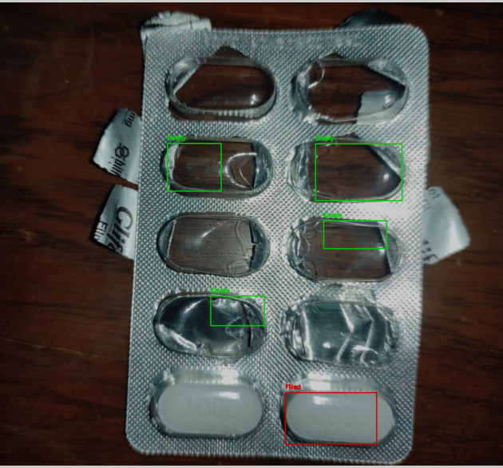
The same operations were performed here as well, as can be seen, the success/capture rate is increasing and we started to get better results.

Slide 10
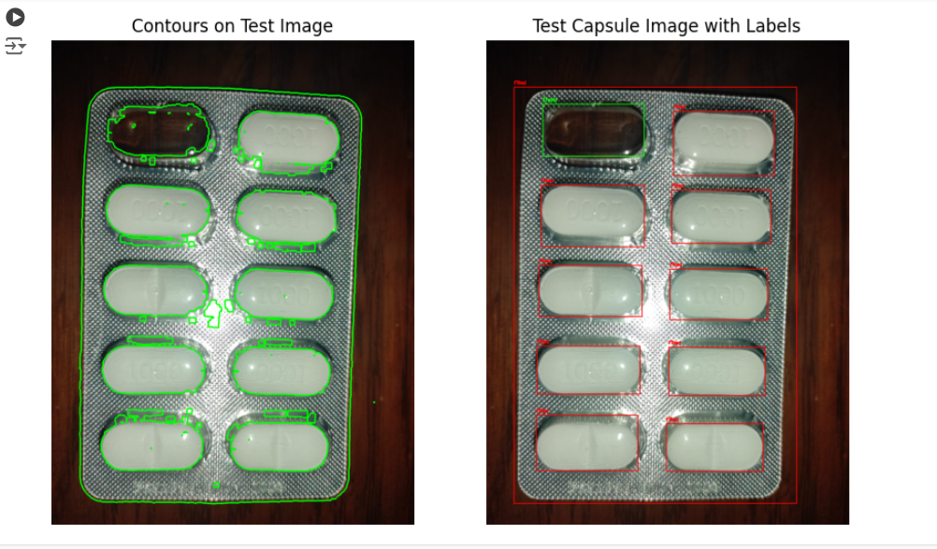
We got results when we tried using the same contours on a undamaged medicine package with an empty capsule from a similar photograph angle and distance.

Slide 11
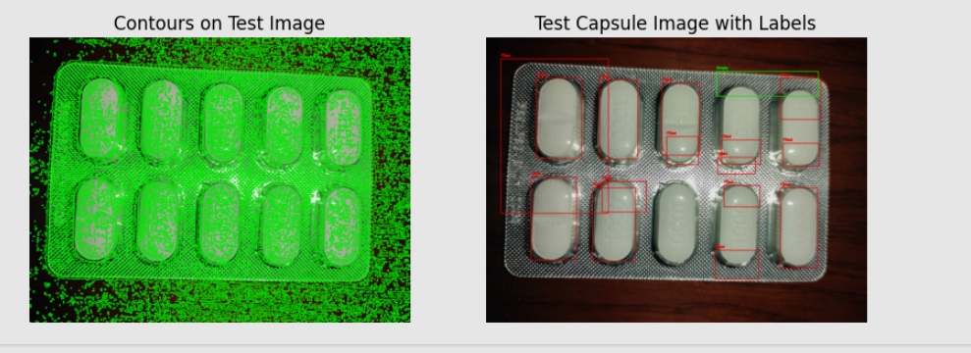
This time, we tried to insert an undamaged medicine package to test it, but it was not successful because we could not detect the contours properly.
Although drug shapes were tried to be obtained in contour detection, consistent results could not be obtained.

Slide 13
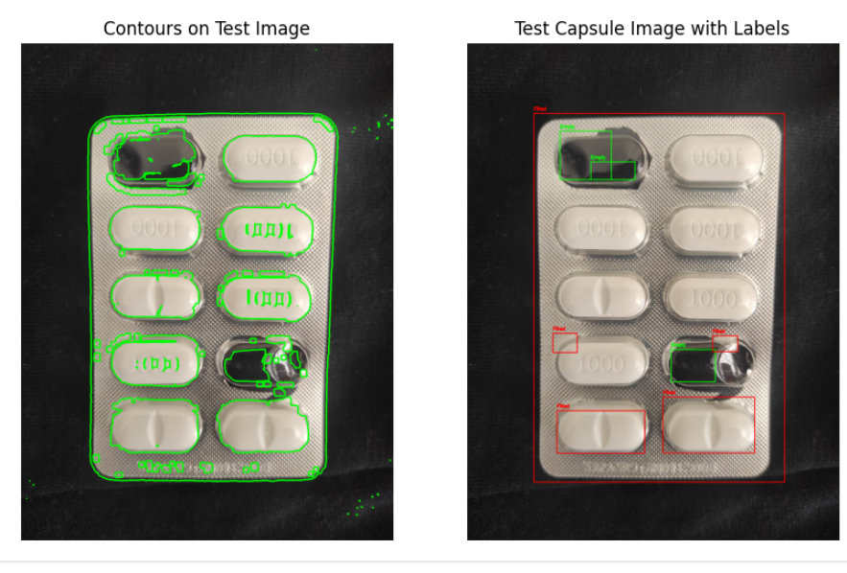
In this stage, we tried to work in a shooting environment where the background was completely dark.
We tried to do this by emptying another capsule from the package.

Slide 14
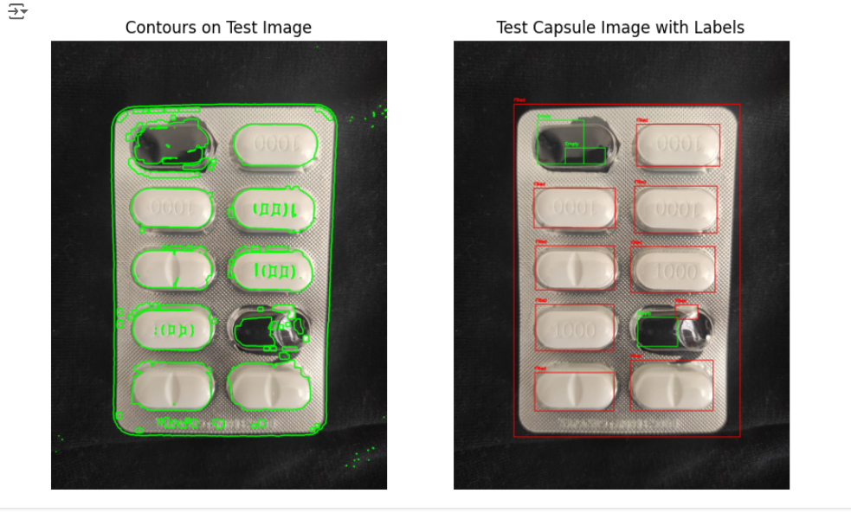
By lowering the threshold value used for histogram similarity compared to the previous photo, we applied a little more filter to the test photo.
Finally, when we changed all the filters and values ​​(w, h, canny, kernel etc.) in accordance with the height and horizontal values ​​of the capsule, we obtained results we wanted.
Final results for a fixed work environment(or isolated) with a distance and shooting angle we chose.

